Slide 1
Towards Error-free, Gapless, Chromosome Scale, Haplotype Assemblies
Matt Settles, PhD
UC Davis Bioinformatics Core
December 16, 2020

Slide 2
Human Genome
In 1990, the National Institutes of Health (NIH) and the Department of Energy joined with international partners to sequence the human genome.
In April 2003, researchers successfully completed the Human Genome Project, under budget ($2.7B) and more than two years ahead of schedule.
Thousands of people contributed the Human Genome Project
Even so, there remains ~400 gaps in the human reference sequence assembly representing hundreds of millions of bases.

Slide 3
Renewed focus on genomes
Sequencing has become more democratic. For example, it took more than 50 people, around a dozen centers, $50 million and half a decade to generate a draft chimpanzee genome, published in 2005. This year, Eichler's lab completed a gorilla sequence for about $70,000. “That, to me, is a big deal,” he says.
Also a big deal, says Eichler, is the quality of their sequences. An earlier version of a gorilla genome was published in 2012 but that was done with shorter pieces of DNA, and therefore left hundreds of thousands of gaps. His team used long-read technology, closed 90 percent of those gaps, and was able to complete many genes that were only partially sequenced in the first attempt.
Speed-reading the genome:
Cheaper methods of sequencing are opening up doors for new research and new career paths.
http://www.nature.com/naturejobs/science/articles/10.1038/nj0492 2016

Slide 4
The Earth Biogenome Project
Ambitious project to sequence all Euk life on Earth (~1.5M species) in 20 years time, for about similar total cost as the Human Genome Project ($4.7B). https://www.pnas.org/content/115/17/4325
Umbrella consortium of many existing genome projects including:
5,000 Insect Genomes (i5K)
10,000 Bird Genomes (B10K)
10,000 Plant Genomes (10KP)
California Conservation Genomics Project (Cal CGP)
Darwin Tree of Life (60K organisms on the British Isles)
Fish 10,000 Genomes (Fish 10K)
Genome 10K/VGP (1 genome from each Vertebate genus, ~70K)
Many More
https://www.earthbiogenome.org/

Slide 5
Gorilla Genome
Assembly | 2012 Illumina Assembly | 2016 Pacific Biosystems Assembly
Total length | 3,041,976,159 bp | 3,080,414,926 bp
Contigs | 465,847 | 16,073
Total contig length | 2,829,670,843 bp | 3,080,414,926 bp
Placed contig length | 2,712,844,129 bp | 2,790,620,487 bp
Unplaced contig length | 116,826,714 bp | 289,794,439 bp
Max. contig length | 191,556 bp | 36,219,563 bp
Contig N50 | 11.6 kb | 9.6 mb
Scaffolds | 22,164 | 554
Max. scaffold length | 10,247,101 bp | 110,018,866 bp
Scaffold N50 | 914 Kb | 23.1 Mb
2012 Assembly: ABI capillary sequence and short 35bp Illumina sequence + BAC PE data
2015 Assembly: PACBIO SMRT sequence + BAC PE data, INDEL corrected with Illumina sequence

Slide 6
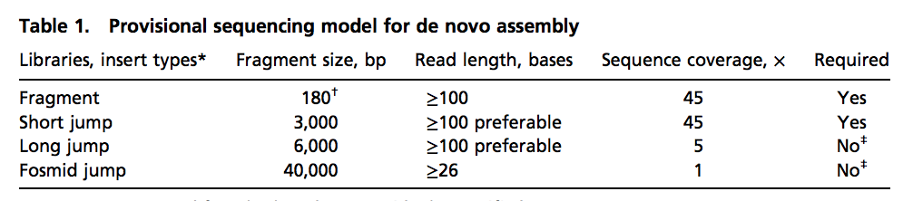
Genome Assembly is converging on more standardized data models
Trend is to consider sample, data generation and bioinformatics together.
ALLPATH-LG, started with specific requirement of sequencing libraries
Discovar
250bp paired-end PCR-free Illumina reads. No other libraries are required.

Slide 7
Advances in high-noise, long-read assembly algorithms
Summer of 2015
Pacific Biosystems Falcon assembler for SMRT assembly of large genomes
Canu fork of Celera Assembler for single-molecule high-noise sequences.
Key features:
Discard all reads shorter than X bp to load into the overlapper, step significantly reduces the number of reads being analyzed.
Self correct reads from all-by-all overlaps (takes advantages of cluster env.)
Build a graph based on high quality, long corrected reads.
“Polish” the resulting assembly using all reads, 60x coverage produces high quality final contigs.

Slide 8
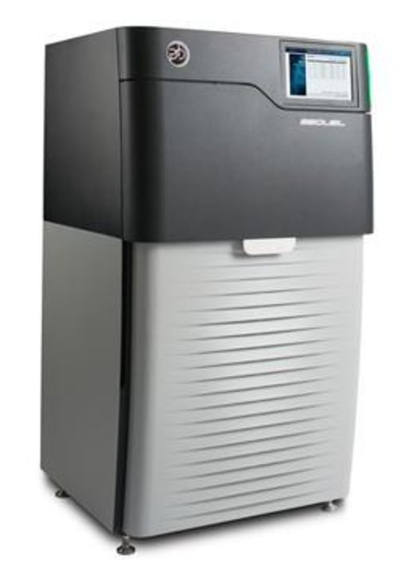
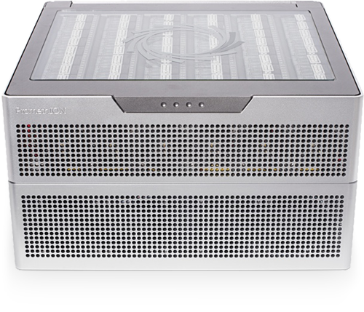
Gapless: The ‘Next, Next’ Generation Sequencers (single molecule, long reads)
Oxford Nanopore
Pacific Biosciences

Slide 9
Towards Gapless assemblies
Promise
Continued progress on DNA input (HMW) and resulting PacBio/Oxford Nanopore read lengths, read depth, and quality will result in longer N50/N90 fewer resulting contigs.
Algorithms are starting to mature, but still have room for improvement.
Issues
Some mis-assemblies are still present, Chimeric reads (PacBio) and sequence bias (ONT) are an issue
Small INDELs, especially homopolymers are an issue and require cleanup (Illumina reads), especially within genes.

Slide 10
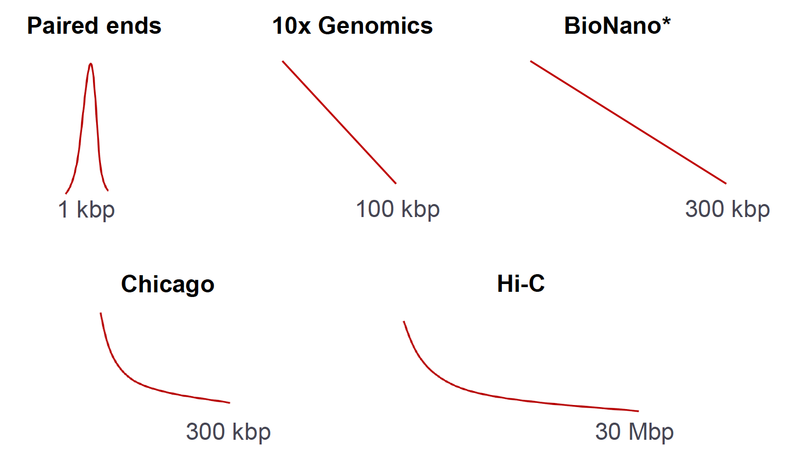
Chromosome Scale: Scaffolding Options
‘Borrowed’ from Sergy Koren talk from PacBio Informatics Developer Meeting in Jan 2017

Slide 11
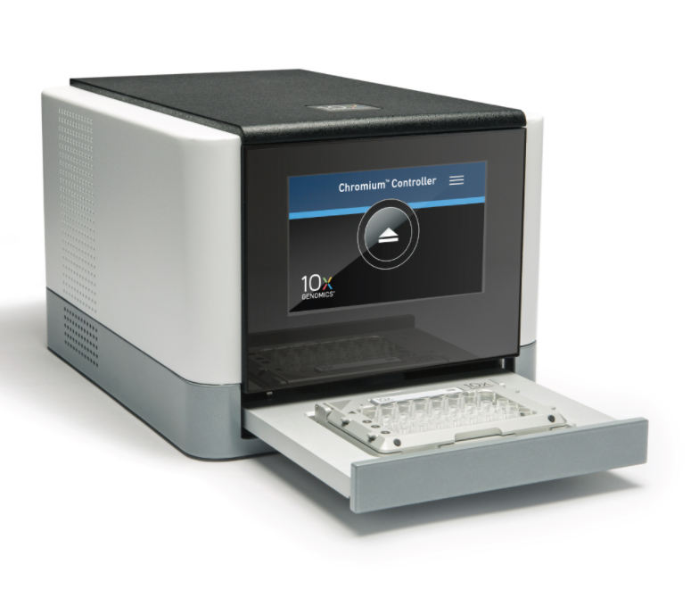
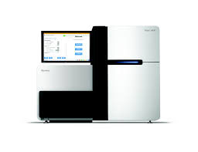
Linked Reads Technology - 10x genomics
10x Genomics, Linked reads technology
Illumina machines, Sequencing by Synthesis 2x150bp reads.
ARCS - https://github.com/bcgsc/arcs/tree/binomialx2
10x has its own assembler, Supernova

Slide 12
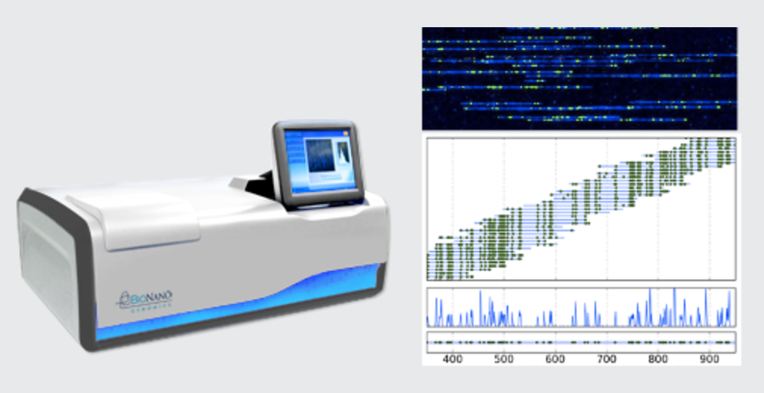
Bionano Genomics
The Irys/Saphyr System puts the power of optical genome mapping. No more waiting for months to get a physical genome map. Bionano Next-Generation Mapping (NGM) provides long-range information to reveal true genome structure. Assists genomes assembles to near chromosomal arms.
Not sequencing based

Slide 13
Dovetail Chicago and Hi-C (Cross Linking) on Illumina
Hi-C
Proximity Guided Scaffolding
Dovetail Chicago Libraries
Dovetail and Phase Genomics

Slide 14
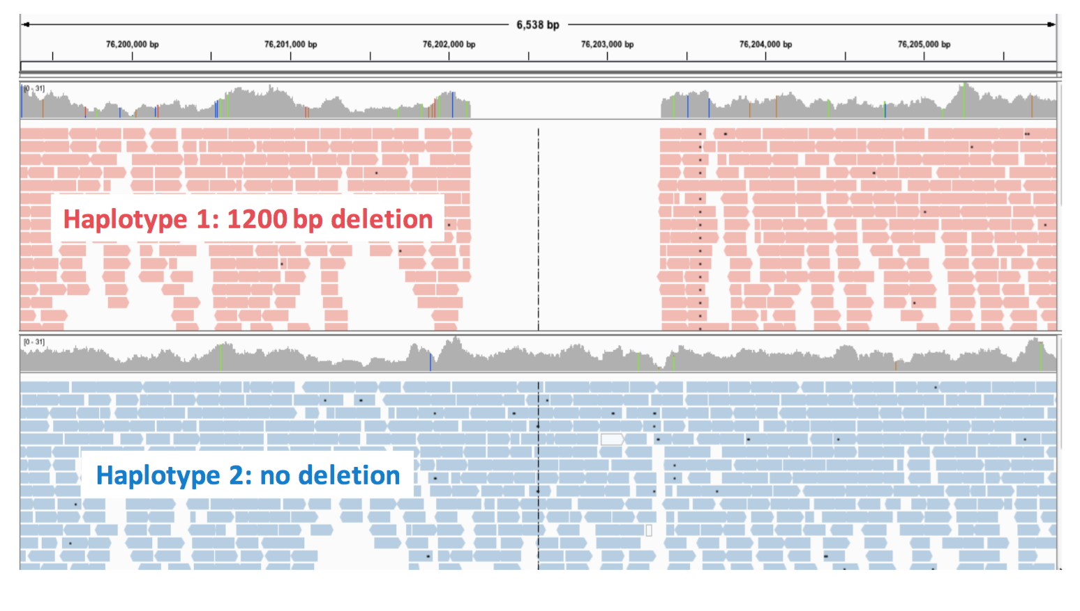
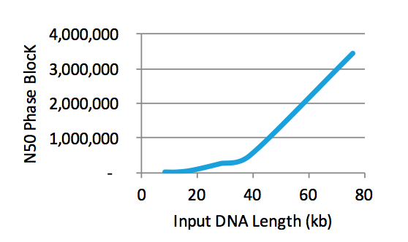
Phasing: Linked Reads + high quality Illumina data

Slide 15
The Kitchen Sink
Available Technologies
Long Reads: Pacific Biosystems / Nanopore Long Contigs
Optical Maps: BioNano Scaffolding
Linked Reads: 10x Genomics High base quality and phasing
Cross Linking: Hi-C / Dovetail Chicago Scaffolding
What the best combination, are all necessary? As algorithms improve, which become unnecessary
Genome 10K project: Sequence 10,000 Invertebrates

Slide 16
Goat Genome
 | CHIR_2.0 (BGI) - 2012 | ARS1 - 2016
 | 14 Illumina PE libraries + Opgen | Pac Bio + Bionano + Hi-C
Coverage | 175x | 69x (@ 5.1Kb mean read length)
Assembly length | 2.8 Gb | 2.9Gb
Number of contigs | 173,141 | 3,074
Contig N50 | 73.5 Kb | 18.7 Mb
Number of scaffolds | 103,494 | 31 (chromosomes)
Scaffold N50 | 9 Mb | 87.3Mb
Adding in the optical maps from the Irys system reduced the total number of contigs to 1,780, with a contig N50 of 10.2 megabases. "The optical mapping increased the quality and confidence of the initial scaffolds," Phillippy said. The three technologies—PacBio, Bionano, and Hi-C—ended up being complementary to each other, he added. Finally, Illumina data is used to polish and make error corrections at the base level. GenomeWeb “Goat Genome Demonstrates Benefits of Combining Technologies for De Novo Assembly”, Mar 07, 2017

Slide 17
Order: The Kitchen Sink
Available Technologies
Long Reads: Long Contigs
Pacific Biosystems (HiFi), Oxford Nanopore (Possibly UL for scaffolding)
Optical Maps: Scaffolding
BioNano
Linked Reads: 10x Genomics High base quality and phasing
TELL-Seq, stLFR (BGI), CPTv2-seq (Illumina)
Cross Linking: Hi-C Scaffolding
Phase, Arima, Dovetail (OmniC)
Make sure you have enough sample at the start of the project to add techniques over time
Algorithms to improve combining data will improve over time
2 or 3
4
1
2

Slide 18
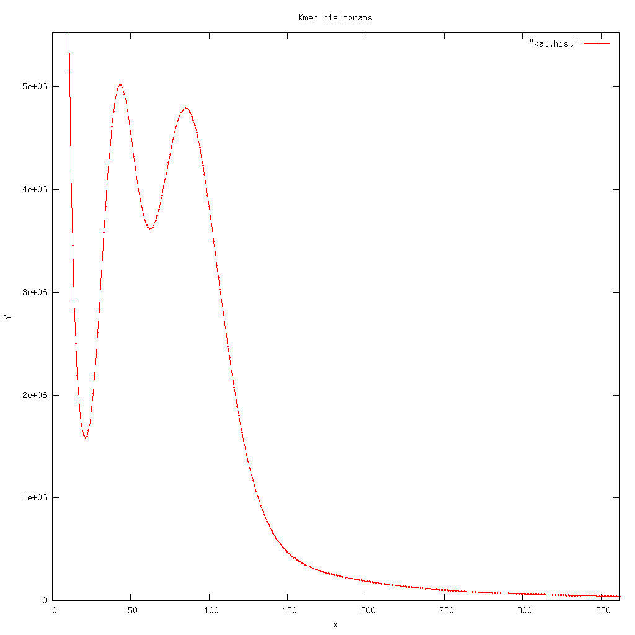
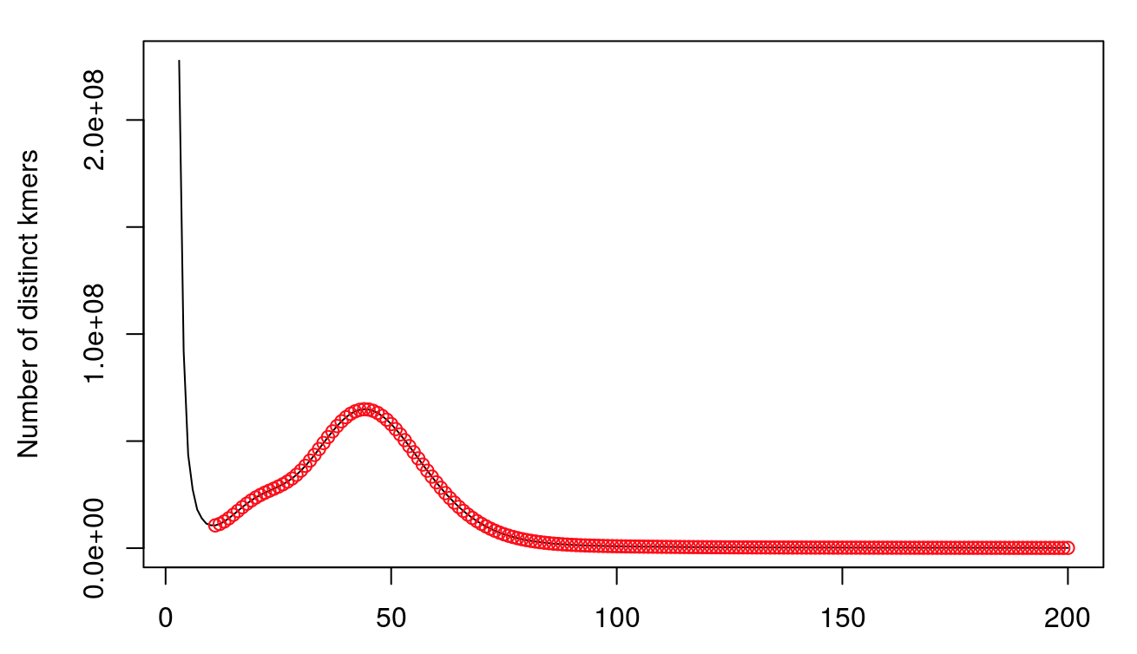
Recommend to start with Linked Reads
Relatively Cheap
Best case scenario, adequate genome and can stop
Kmer profiles and estimate genome size
High quality Illumina data for polishing long reads
Linked read data for scaffolding and haplotyping

Slide 19
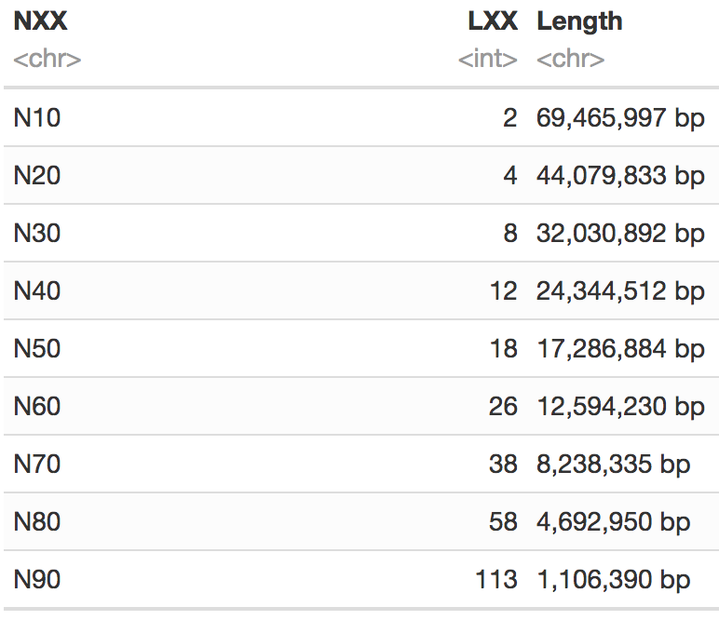
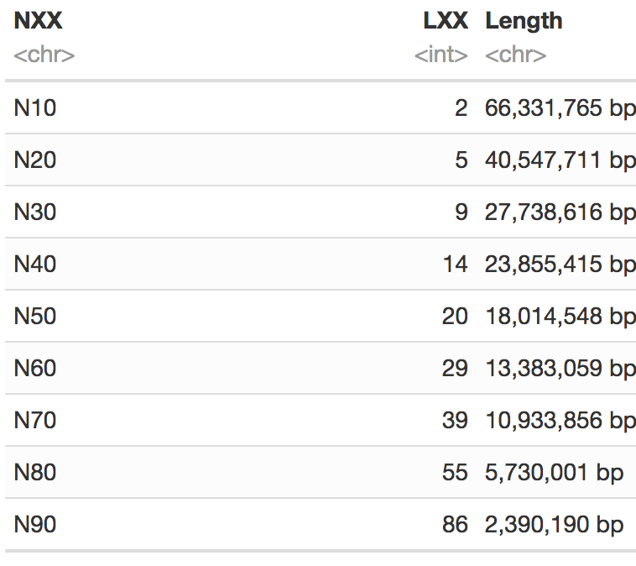
California Condor – PacBio vs 10x
$70K of PacBio - $4,000/MB of N50
$4K of 10X genomics - $220/MB of N50
The assembly contained 2.82% (35,325,300bp) uncharacterized ‘N’ basepair.

Slide 20
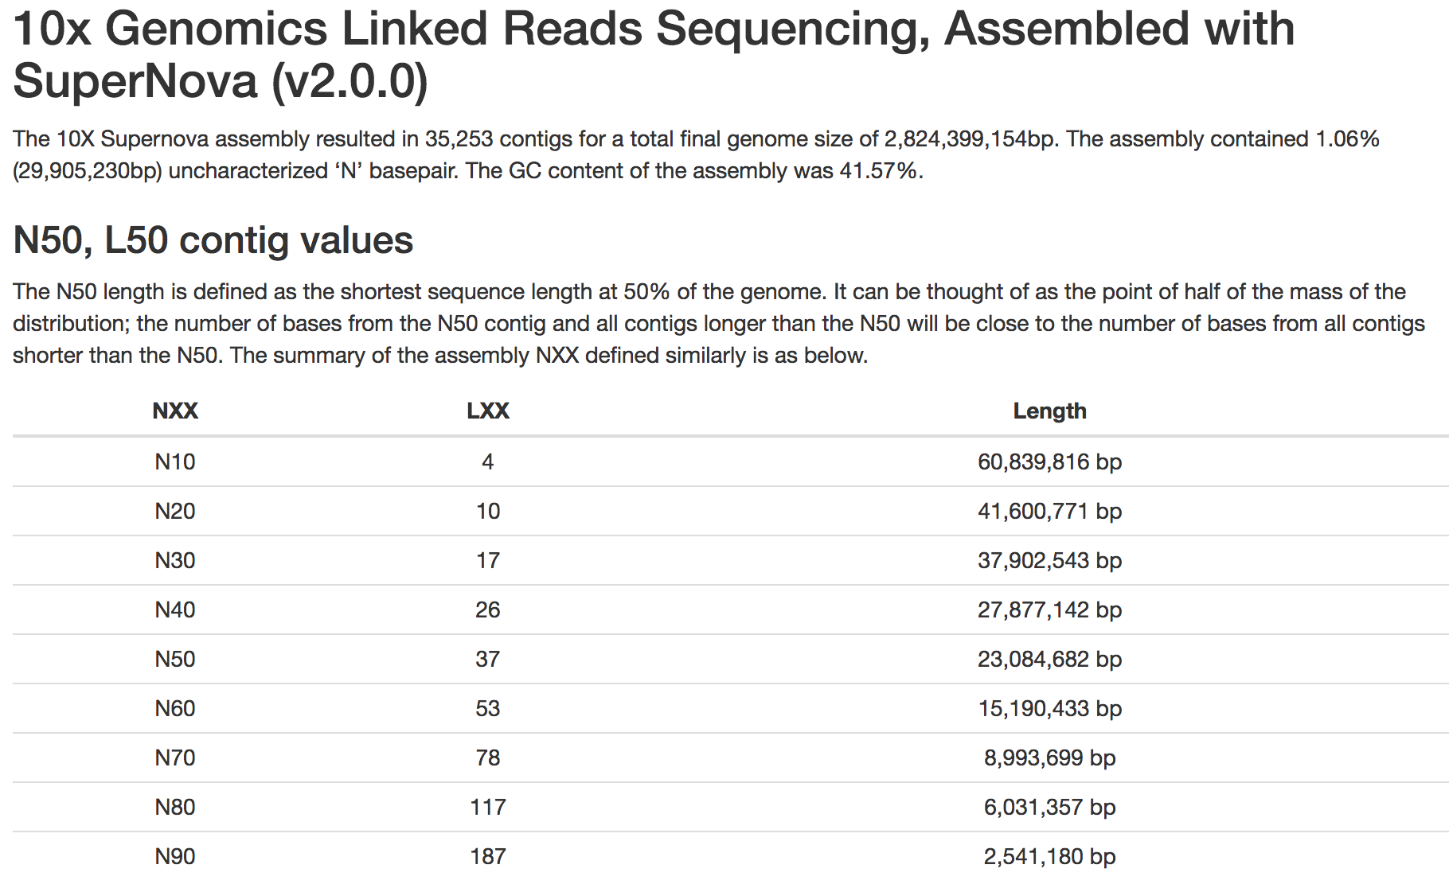
Black Tailed Deer

Slide 21
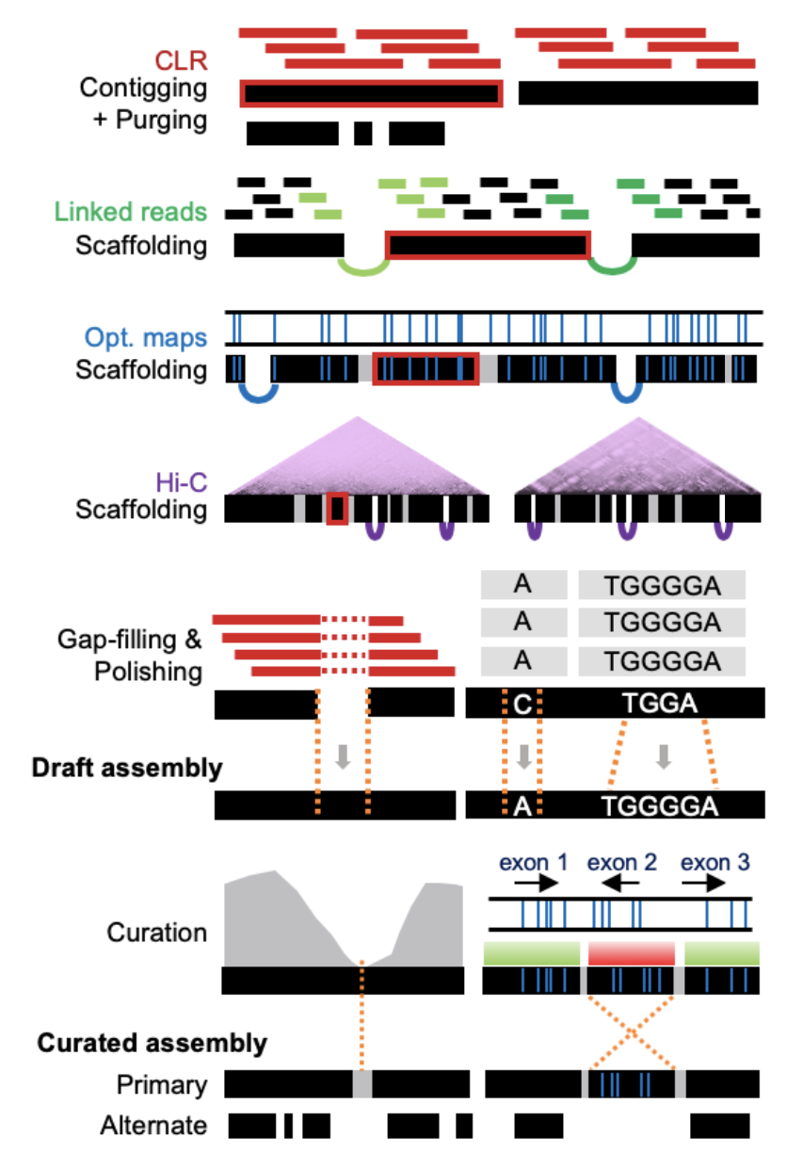
VGP Paper Towards complete and error-free genome assemblies of all vertebrate species May 23, 2020 https://www.biorxiv.org/content/10.1101/2020.05.22.110833v1
Evaluation of data types and algorithms
Pipeline development
Establishment of assembly standards

Slide 22
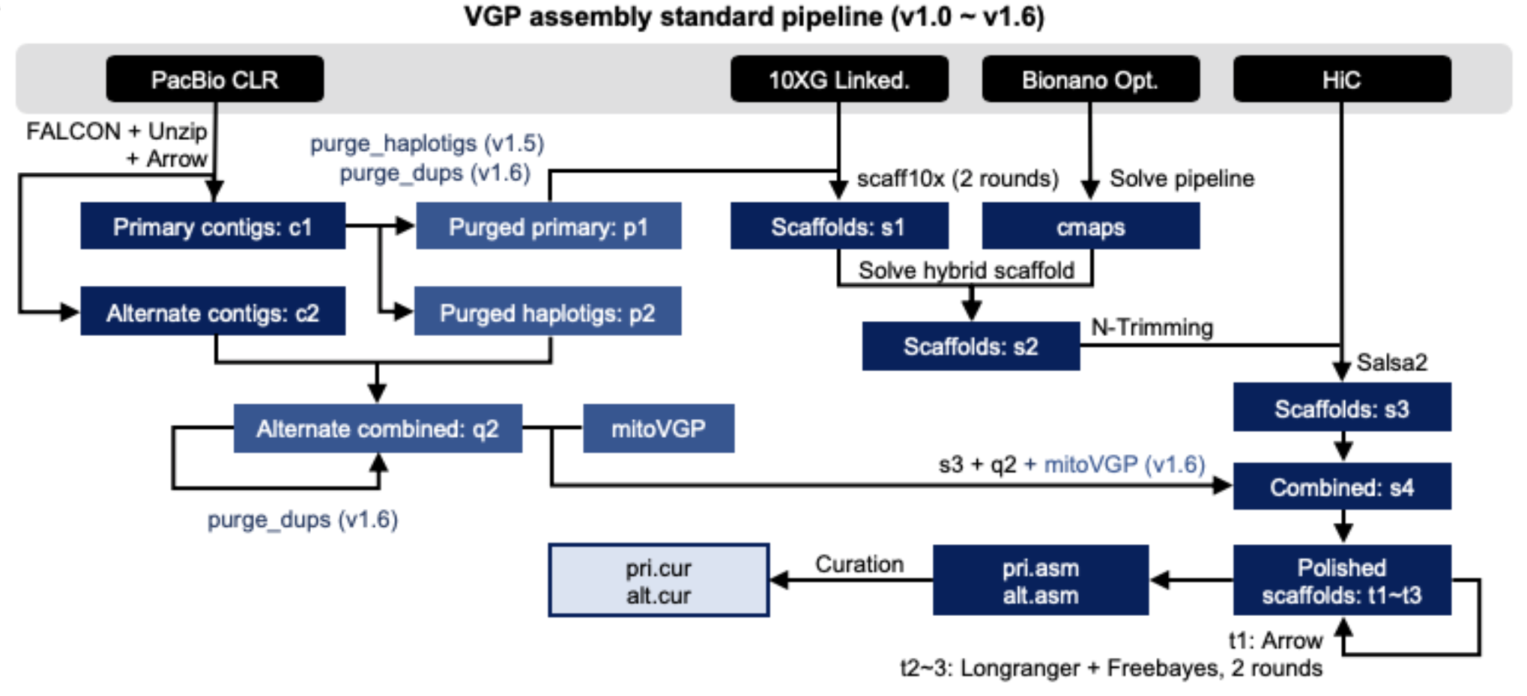
VGP Paper (Pipeline v1.0 - v1.6)

Slide 23
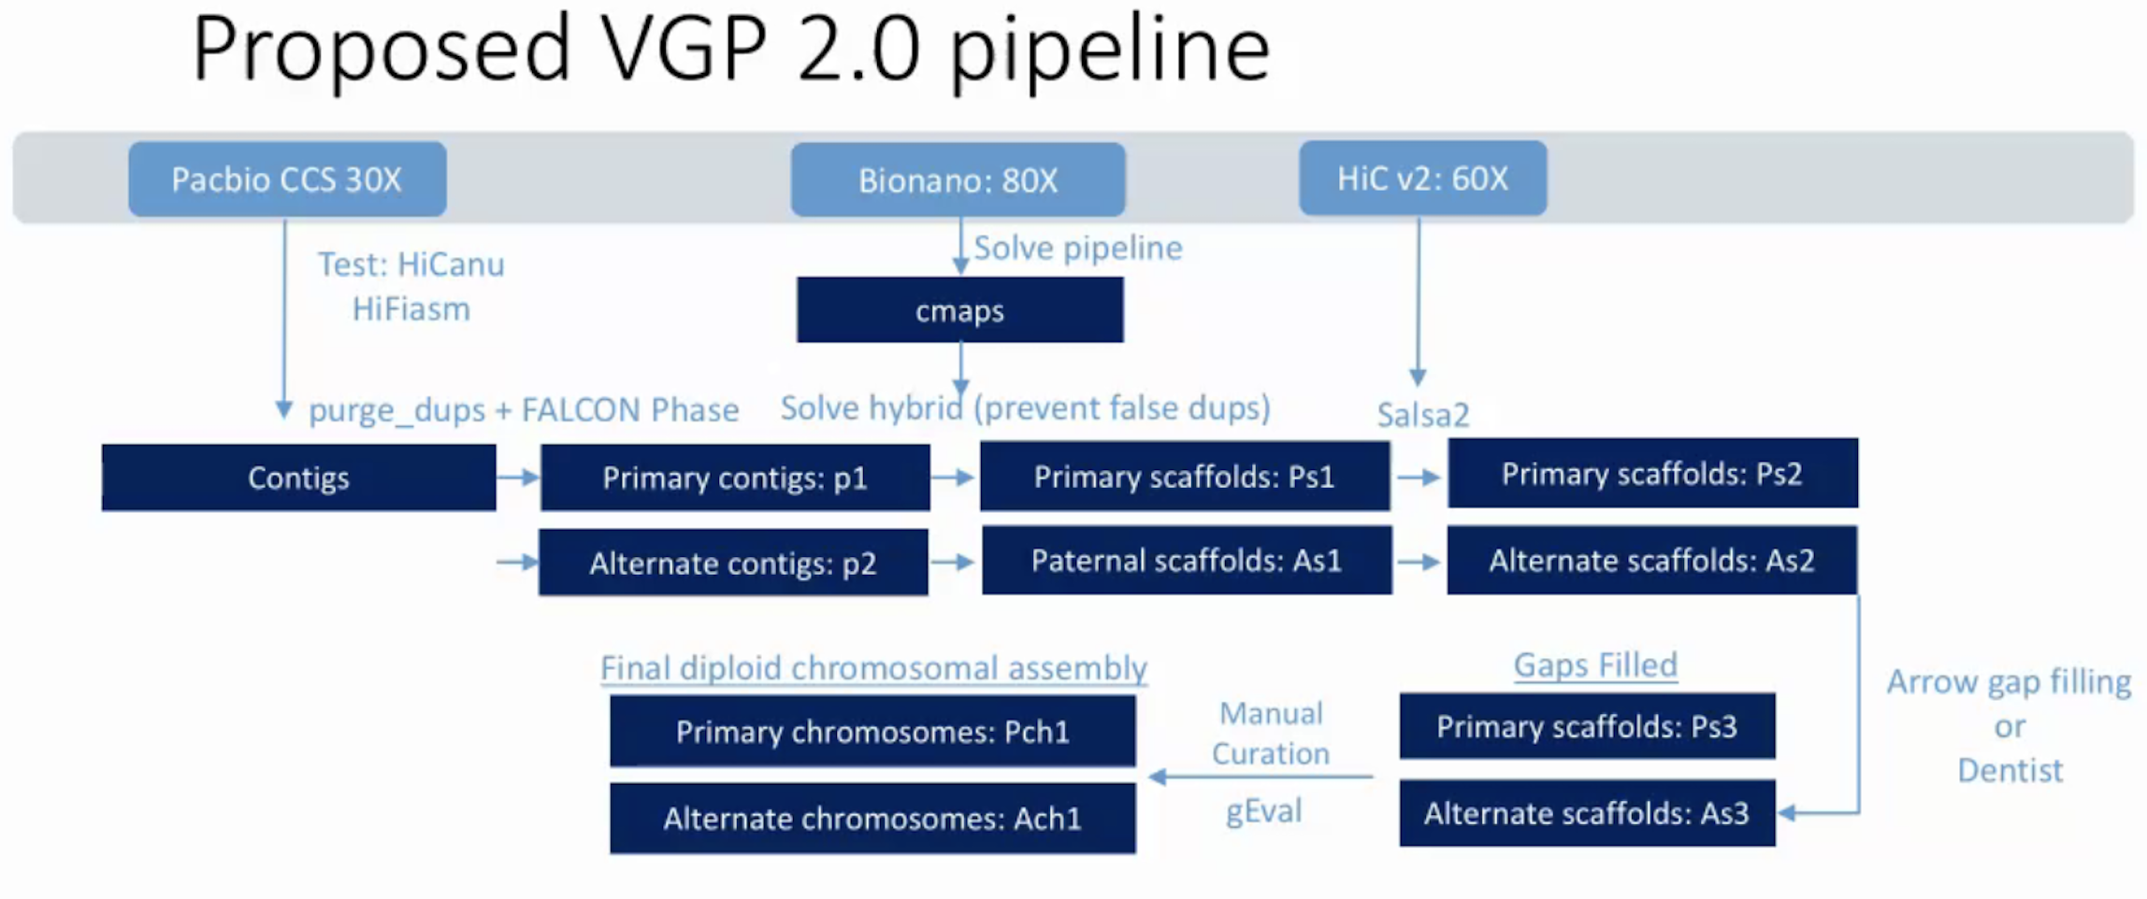
VGP (Proposed Pipeline V2.0)

Slide 24
T2T Consortium https://sites.google.com/ucsc.edu/t2tworkinggroup
The first end-to-end (no gaps) Human Chromosome (X Chromosome), published July 14, 2020. https://www.nature.com/articles/s41586-020-2547-7
50X coverage of ultra-long Oxford Nanopore sequencing, including 44 Gb of sequence in reads 100 kb+ and a maximum read length exceeding 1 Mb.
A ​de novo ​assembly combining this nanopore data with 70X of existing PacBio data achieved an NG50 contig size of 75 Mb (compared to 56 Mb for GRCh38), with some chromosomes broken only at the centromere.
Using this assembly as a basis, T2T chose to then manually finish the X chromosome. The few unresolved segmental duplications were assembled using ultra-long reads spanning the individual copies, and the ~2.8 Mbp X centromere was assembled by identifying unique variants within the array and using these to anchor overlapping ultra-long reads.

Slide 25
Focus of the Future
To some extent we are limited by being able to generate enough (quantity) high quality, high molecular weight DNA.
Continued improvement to sequencing chemistries for consistent (PacBio Hifi CCS Reads) and longer reads, read quality improvement has become secondary.
Incremental improvement of the computational algorithms.
Scaffolding algorithms, algorithms merge multiple data types/sources (GFA2).
Polyploidy is now doable and an active area of research.
Haplotyped genomes – But how to really use the data.

Slide 26
Graphical Format Assembly - GFA2
Assembly is a pipeline
Overlap
Layout
Consensus
With a common input (fastq) and common output (fasta), but no common intermediate file format, causes a duplication of effort.
GFA2 - Common file format for assembly graph representation
Direct graph visualization, manipulation
Modular assembly tools (heterozygous/mis-assembled contigs)
Modular scaffolding tools
Graph aware annotation

Slide 27
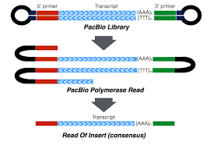
Annotation – Pac bio Iso-seq
Produce full-length transcripts without assembly
The isoform sequencing (Iso-Seq) application generates full-length cDNA sequences — from the 5’ end of transcripts to the poly-A tail — After Circular consensus sequence (CCS) algorithm produces high quality isoforms.

